Slide 1
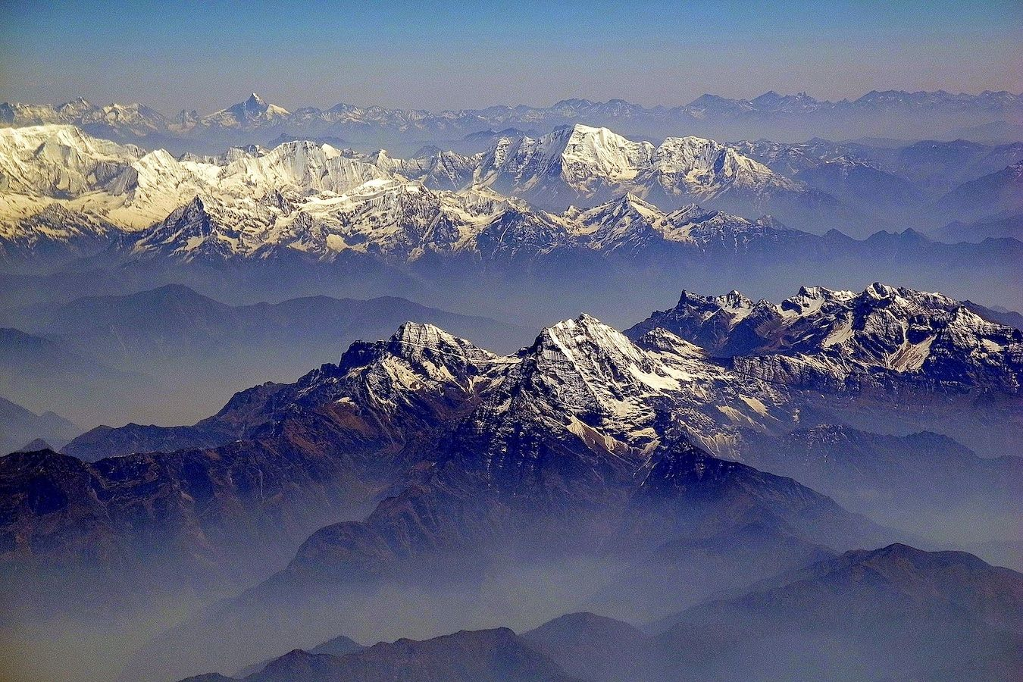
The LS4P Side Meeting
Ninth GEWEX Open Science Conference
Sapporo Japan, 10, July 2024

Slide 2
LS4P Phase II Major Objectives
(2023-2026)
(1). Case study for 1998 (May-August 1998): Cold Rocky Mountains and Warm Tibetan Plateau in Spring and drought in Southern Great Plains and June flood in Yangtze River, respectively.

Slide 3
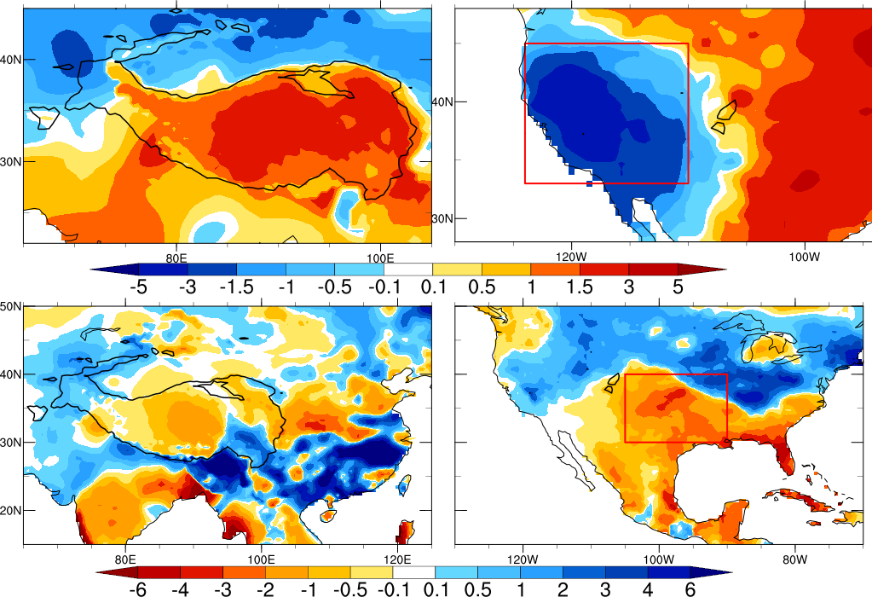
Observed 1998 Anomaly in East Asia (left Column) and North America (Right)
TP>4000m T2m anomaly = 1.35 ℃
RM T2m anomaly = 2.37 ℃
June Precipitation (mm/day) May T2m (°C)
South YTZ precipitation anomaly= 5.65 mm/day SGP precipitation anomaly = -1.3 mm/day

Slide 4
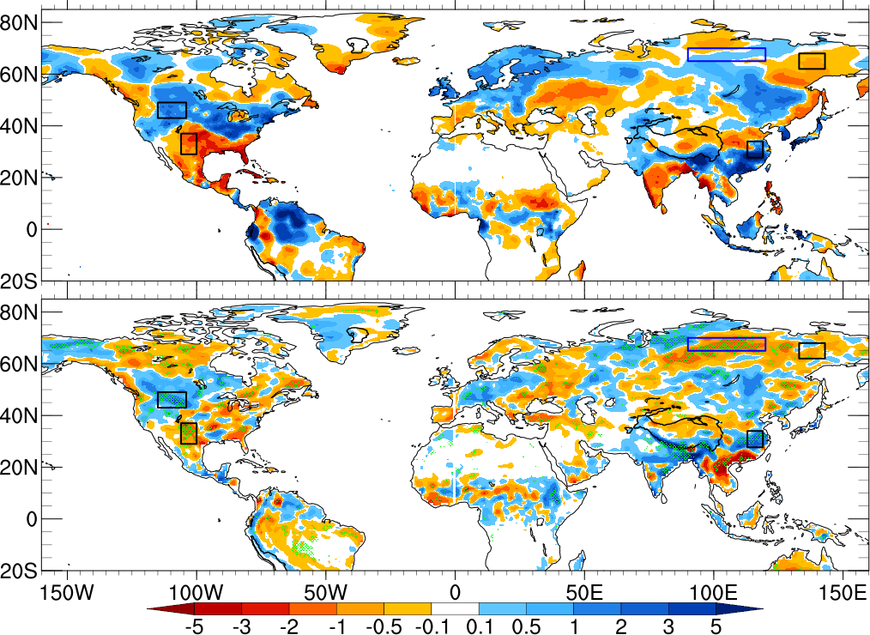
Observed June
1998 Precip.
Jun 1998 Observed Precipitation anomaly (mm/day)
UCLA-NCEP GFS/SSiB2
With RM Mask
Simulated Jun 1998 Precipitation anomaly due to RM LST/SUBT effect (mm/day)

Slide 6
LS4P Phase II Major Objectives
(2) The LS4P research on other years and seasons, such as late summer and winter.

Slide 7
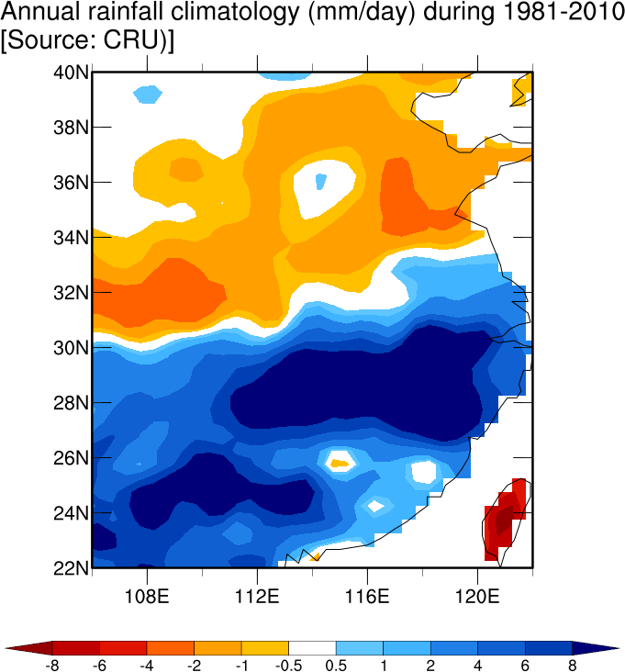
Obseeved June 1-28 2024
Precipitation Anomaly
Observed May 2024 T2m Anomaly
TP T2m Anomaly : 2.56 ℃
S. Yangtze River Precip. Anomaly: 5.7 mm/day

Slide 8
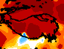
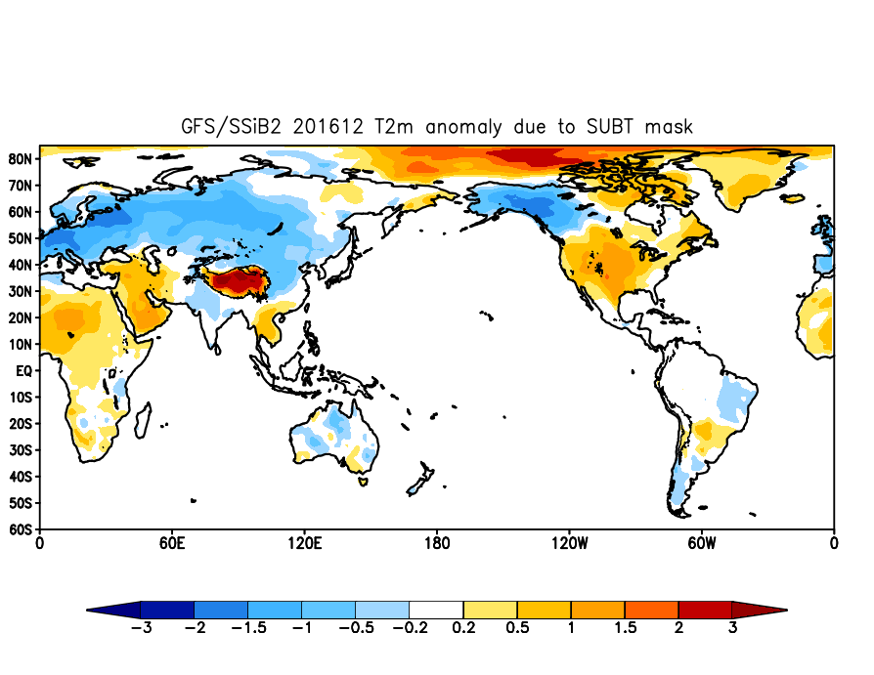
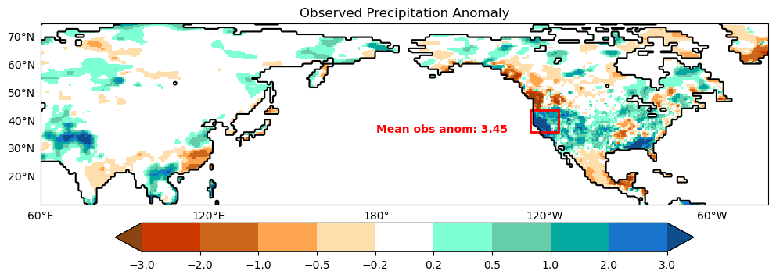
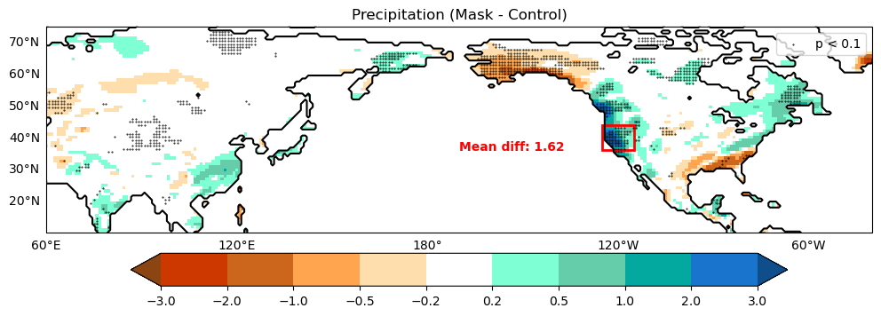
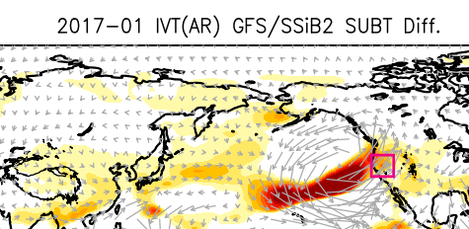
GFS/SSiB2 Diff.
Obv. Anomaly
201612
T2m
1.7
2.8
Ensemble mean Diff: 1.62

Slide 9
EVMWF-IFS Sensitivity Statistics (Preliminary)
LS4P Phase II Major Objectives: (3) Transition to operational applications
 | May 1998 2m Temperature (ºC) |  | June 1998 Precip mm/day
 | Tibetan Plateau |  | S. Yangtze Basin
Obs. Anomaly | 1.404 |  | 5.668
Bias in CONTROL | -3.314 |  | -5.281
Sensitivity Experiments | Experiment minus CONTROL
TP △t n=1 | 0.618 |  | 0.672
TP △t n=3 | 0.717 |  | 1.759
Retish Senan

Slide 10
LS4P Phase II Major Objectives
(4) Coupling Remote and Local Effects
(5) RCM Protocol

Slide 11
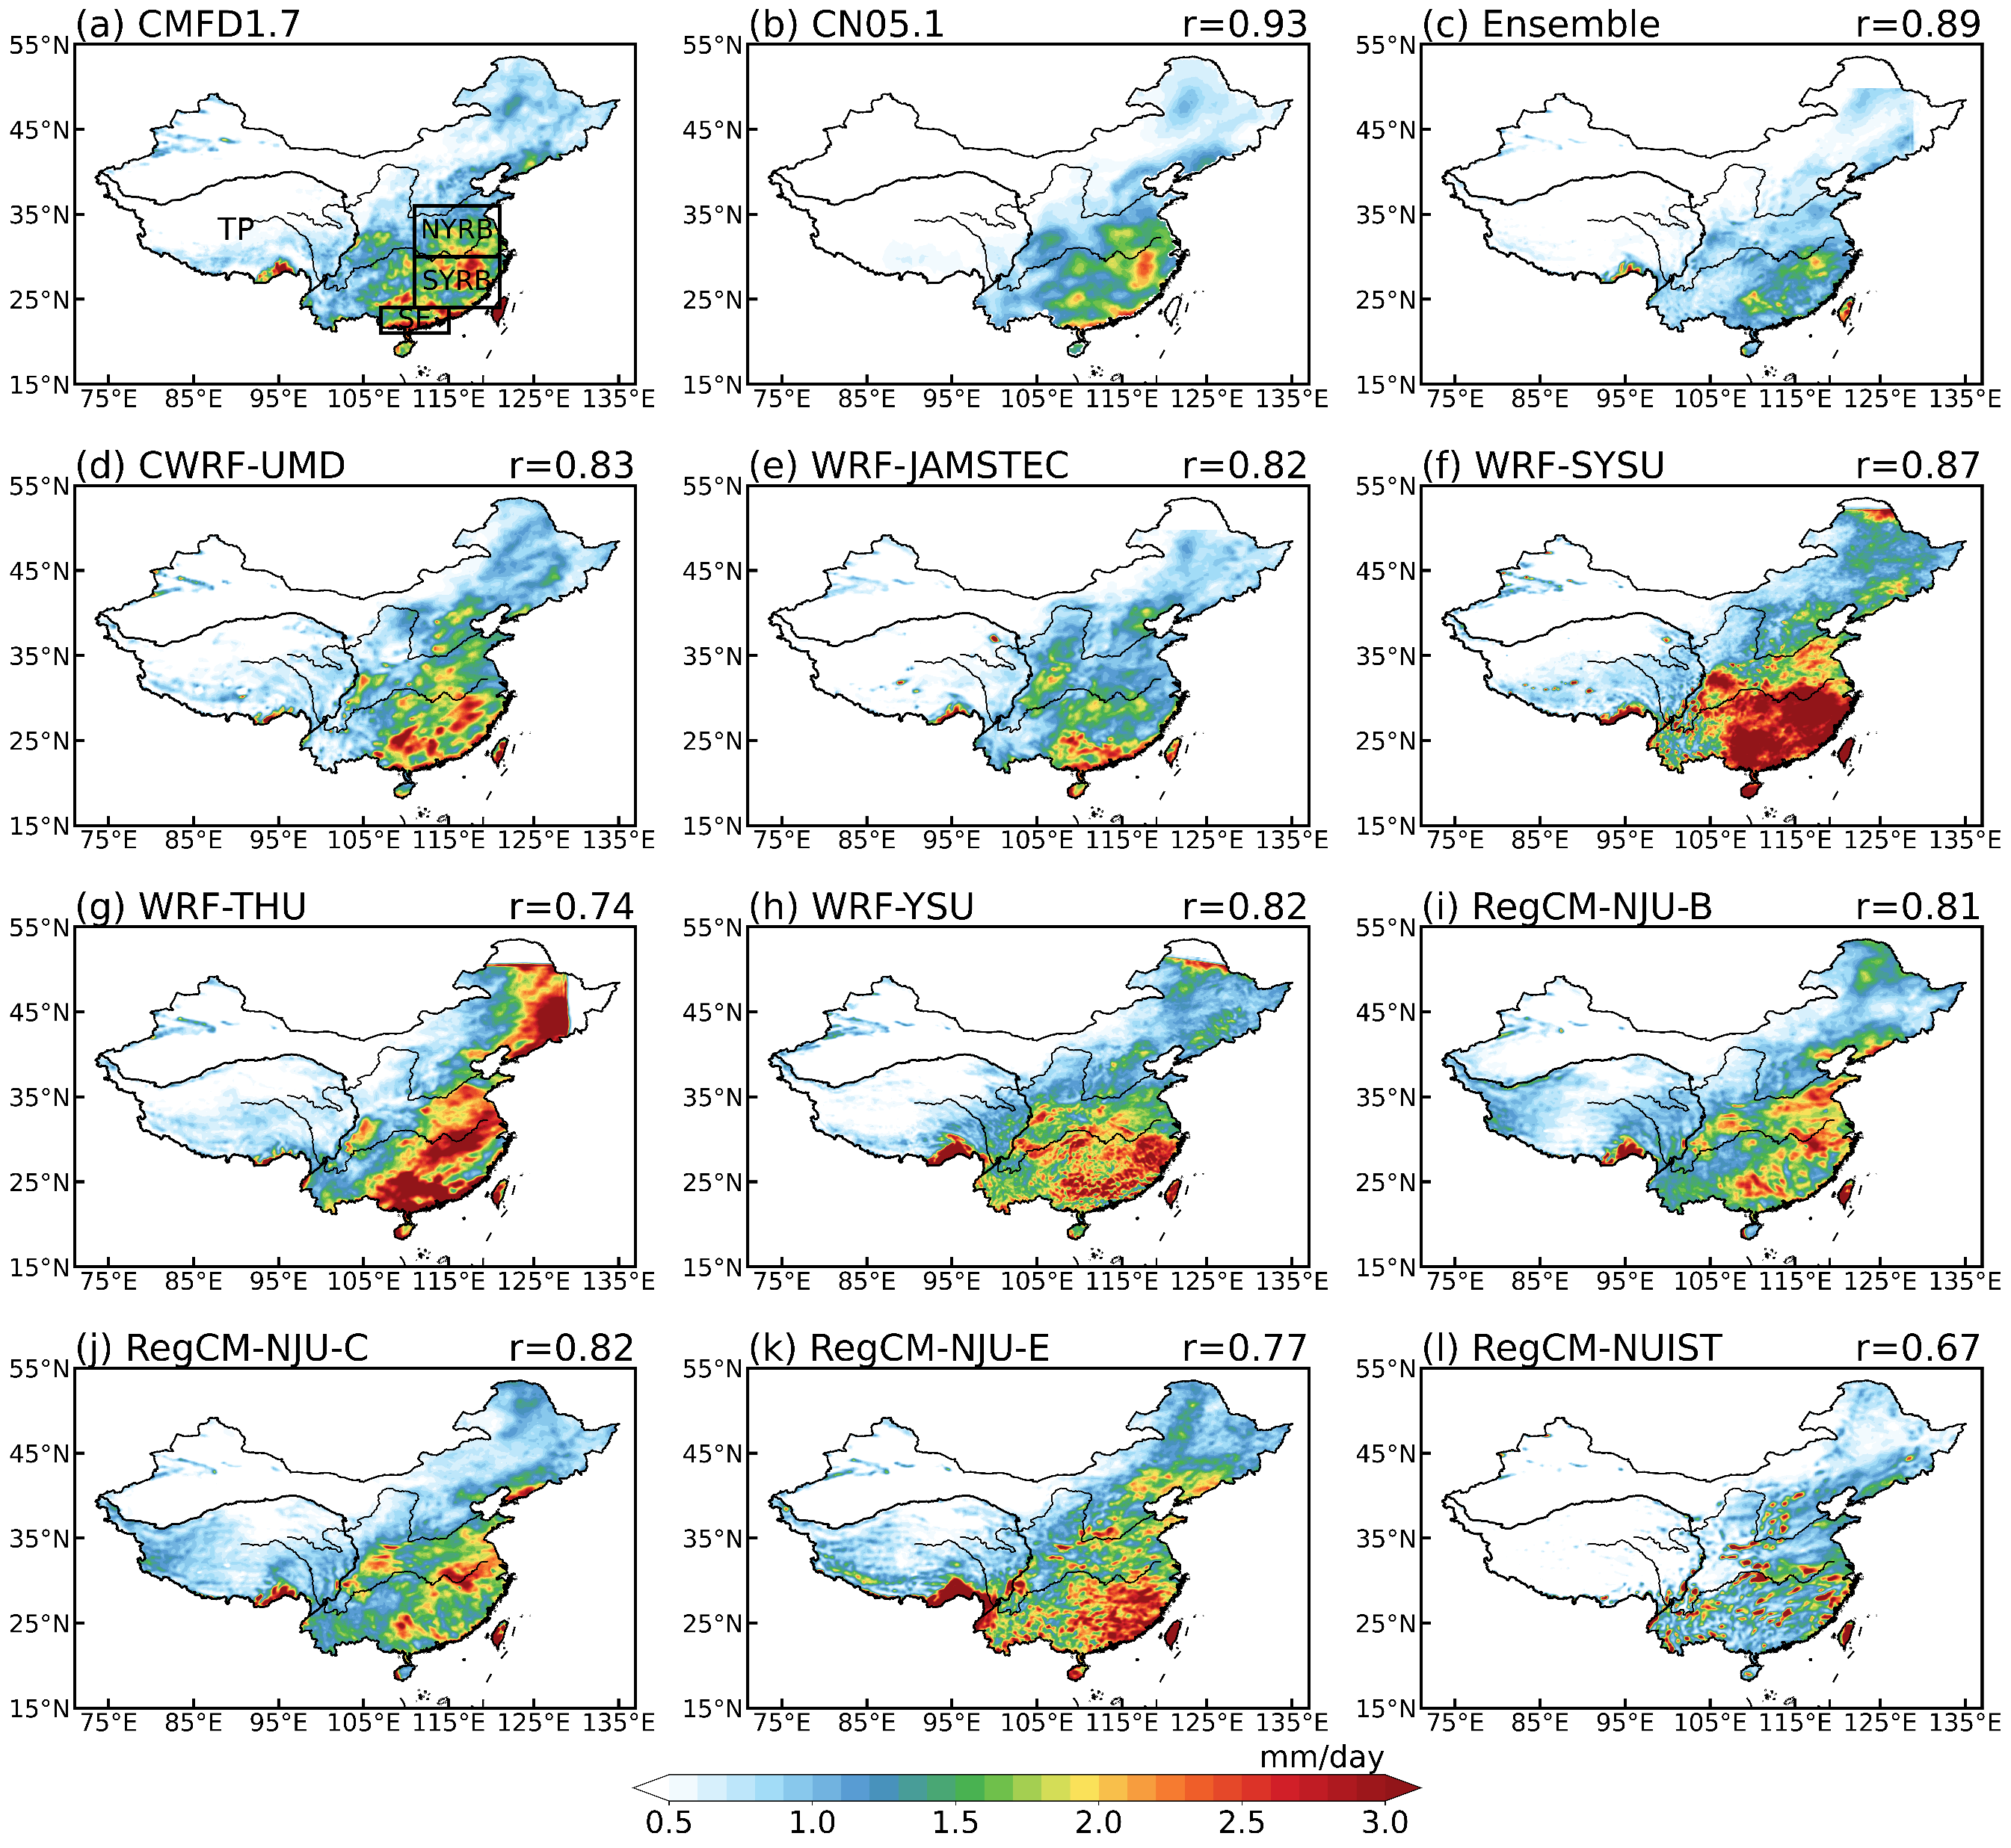
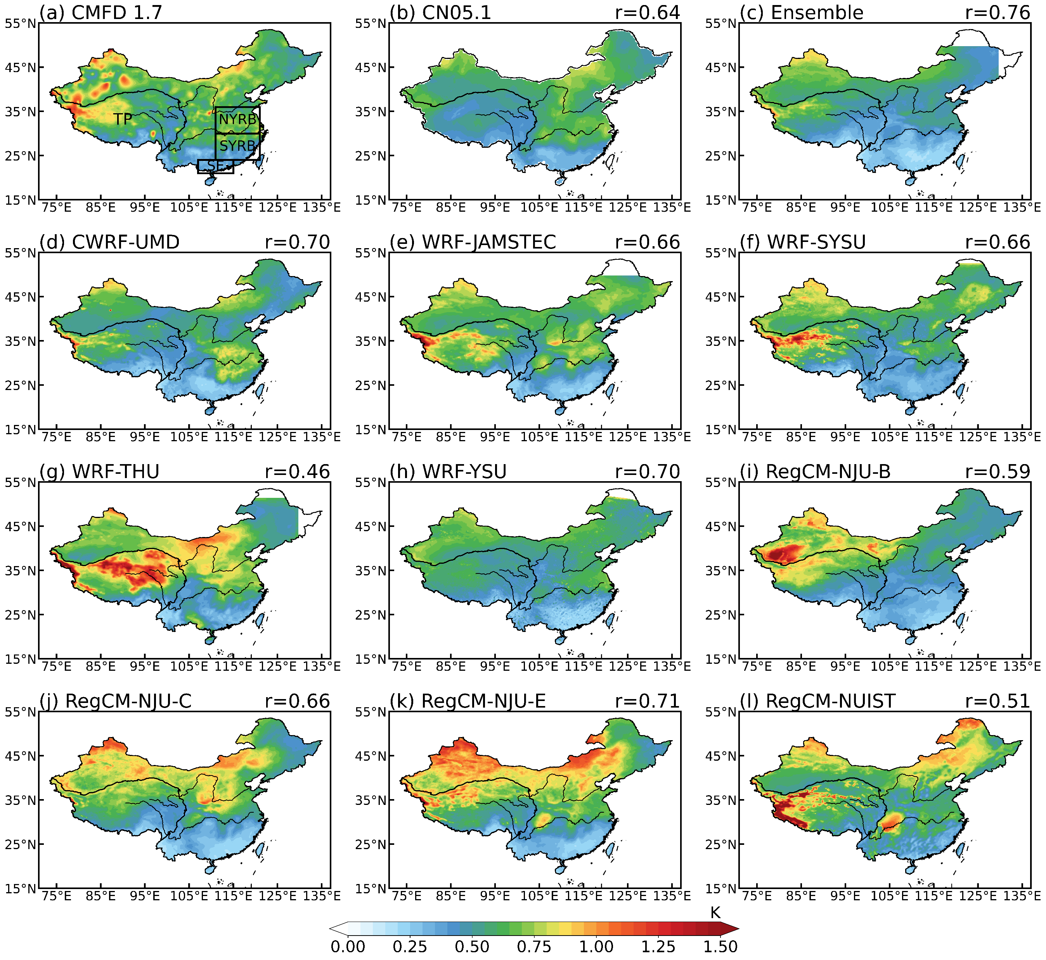
Intercomparison of Regional Climate Models on the Interannual Variabilities in the GEWEX/LS4P Phase I
Miao Yu, Wenchao Wang, Yongkang Xue, Jianping Tang, Guiling Wang, Weiguang Liu, Xin-Zhong Liang, Shiori Sugimoto, Kun Yang, Zhenming Ji, Jinkyu Hong, Jeongwon Kim, Haoran Xu, Tomonori Sato, Hiroshi G. Takahashi, Shuyu Wang, Sin chan Chou, Weidong Guo, Xiaoduo Pan
Interannual variabilities of MJJA Pre and T2m: CMFD observation vs. RCMs
Precipitation
2-m temperature
obs
obs
Standard deviation during 1991-2015

Slide 12
LS4P RCM Phase 2
Prototype Experiments

Slide 13
RCM Evaluation with large scale field data?
African RCM protocol

Slide 14
LS4P Phase II Major Objectives
(5) Many others

Slide 15
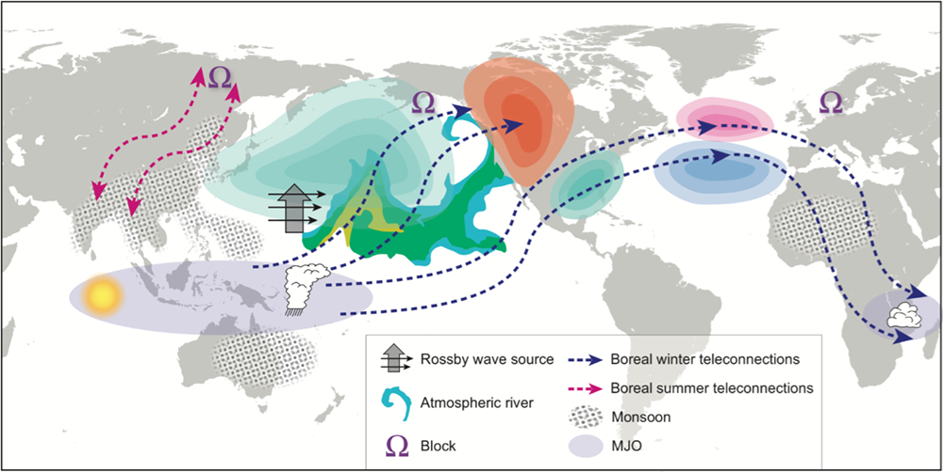
Representing Teleconnections
also stratosphere/troposphere, Poles/High latitude teleconnections, land atmosphere interaction …
Courtesy of Frederic Vitart (Stan et al., 2017)

Slide 16

A dinner starting 19:00 (7pm) in the Jingiskan BBQ Restaurant.
Meet at the main entrance of the Keio Plaza Hotel at 6:30 PM.
Shiori will guide us to go.

